Slide 1
Top-5-European-Leagues-Analysis
Seasons
2017-2018 2018-2019 2019-2020
fbref.com

Slide 2





Top 5 Leagues In Europe

Slide 3
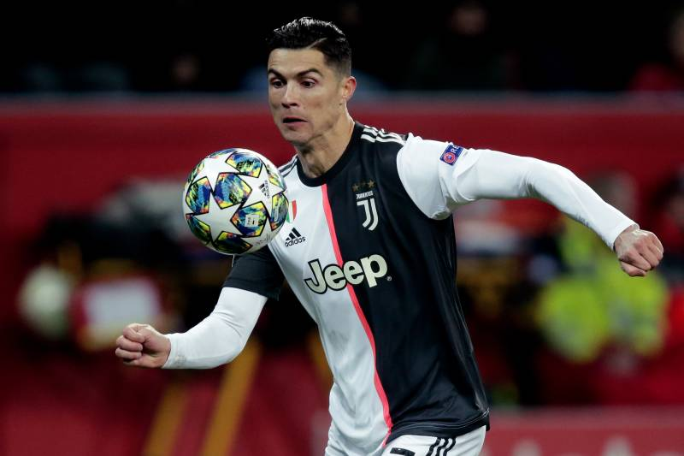

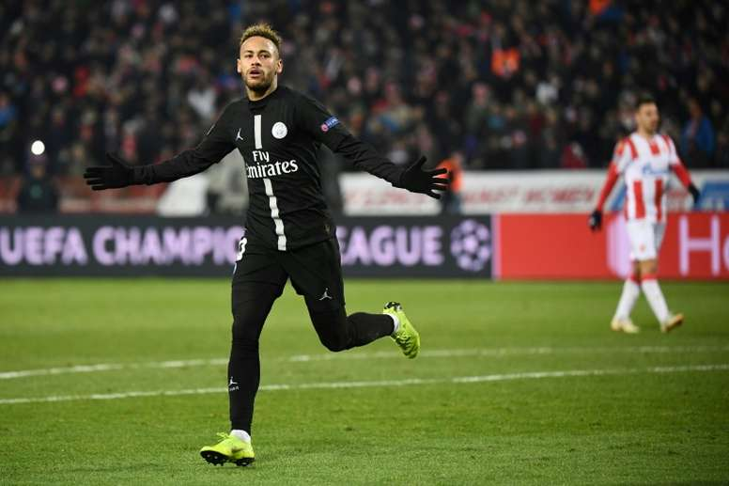




What is the best league in Europe?
Who is the best team in Europe?
Who are the League Champions?
Who are the top 5 strikers in Europe?
What is the players age in Europe?
Who are the top 10 toughest players?
Let’s find out…

Slide 5

Slide Title
Make Effective Presentations
Using Awesome Backgrounds
Engage your Audience
Capture Audience Attention

Slide 6
Slide Title
Make Effective Presentations
Using Awesome Backgrounds
Engage your Audience
Capture Audience Attention

Slide 7
Slide Title
Product A
Product B
Feature 1
Feature 2
Feature 3
Feature 1
Feature 2
Feature 3

Slide 8


